Slide 1
COMP 4332 / RMBI 4310 Big Data Mining (Spring 2019)
Tutorial 3: Recurrent Neural Network
TA: Xin Liu (xliucr@connect.ust.hk)

Slide 2
Recall tutorial 1
1
T
Perceptron
Multi Layer Perceptron
2
7
3
4
5
6
activation
Output
Hidden
Input

Slide 3
Recall tutorial 2
CNN

Slide 4
Recurrent Neural Network
$x_{t−1}$ $x_{t}$ $x_{t+1}$
O O O O O
O O O O O
O O O O O
Several RNN Layers
1 cell for a unidirectional layer
2 cells for a bidirectional layer
O O O O O
O O O O O
O O O O O
$h_{t−1}$ $h_{t}$ $h_{t+1}$
$y_{t−1}$ $y_{t}$ $y_{t+1}$
$x_{t−1}$ $x_{t}$ $x_{t+1}$
O O O O O
O O O O O
O O O O O
${\tilde{h}}_{t−1}$ ${\tilde{h}}_{t}$ ${\tilde{h}}_{t+1}$
O O O O O
O O O O O
O O O O O
O O O O O
O O O O O
O O O O O
$h_{t−1}$ $h_{t}$ $h_{t+1}$
$y_{t−1}$ $y_{t}$ $y_{t+1}$

Slide 5
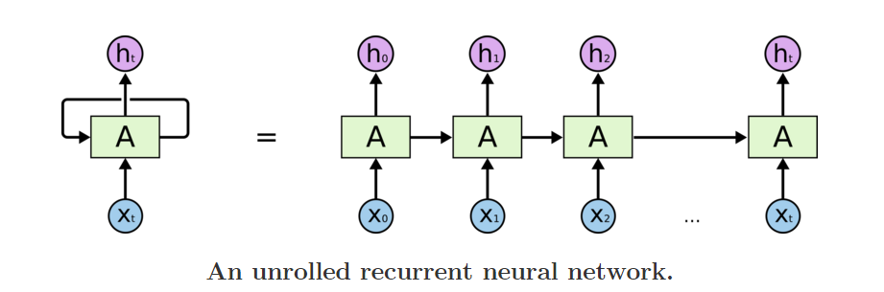
Recurrent Neural Network Cell

Slide 6

LSTM Cell

Slide 7
Recurrent Layer
RNN
keras.layers.SimpleRNN(
units=128, return_sequences=True, return_state=True)
LSTM
keras.layers.LSTM(
units=128, return_sequences=True, return_state=True)
GRU
keras.layers.GRU(units= 128
units=128, return_sequences=True, return_state=True)

Slide 8
Recurrent Layer
BiRNN
keras.layers.Bidirectional(keras.layers.SimpleRNN(
units=64, return_sequences=True, return_state=True))
BiLSTM
keras.layers.Bidirectional(keras.layers.LSTM( units=64, return_sequences=True, return_state=True))
BiGRU
keras.layers.Bidirectional(keras.layers.GRU( units=64, return_sequences=True, return_state=True))

Slide 9
Sentiment Analysis
Simplest task:
Is the attitude of this text positive or negative?
More complex:
Rank the attitude of this text from 1 to 5
(3/5) The room was clean and everything worked fine – even the water pressure
(1/5) …the worst hotel I had ever stayed at ...
Advanced:
Detect the target, source, or complex attitude types

Slide 10
Architecture
$x_{t−1}$ $x_{t}$ $x_{t+1}$ ... $x_{L}$
Embedding Layer
$e_{t−1}$ $e_{t}$ $e_{t+1}$ ... $e_{L}$
O O O O O
O O O O O
O O O O O
O O O O O
...
O O O O O
O O O O O
O O O O O
O O O O O
$h_{t−1}$ $h_{t}$ $h_{t+1}$ ... $h_{L}$
Dense Layer
$y$

Slide 11
Constructing the Sequence Matrix
46 for j, word in enumerate(doc):
47 # YOUR CODE HERE
48 if j == seq_length:
49 break
50 word_idx = vocab_dict.get(word, 1) # 1 means the unknown word
51 data_matrix[i, j] = word_idx

Slide 12
Adding the Embedding Layer
125 # embedding layer and dropout
126 # YOUR CODE HERE
127 model.add(Embedding(input_dim=input_size, output_dim=embedding_size, input_length=input_length))
128 model.add(Dropout(dropout_rate))

Slide 13
Adding the LSTM Layer
130 # LSTM layer
131 # YOUR CODE HERE
132 model.add(LSTM(units=hidden_size))

Slide 14
Adding the Output Layer
134 # output layer
135 # YOUR CODE HERE
136 model.add(Dense(K, activation='softmax'))

Slide 15
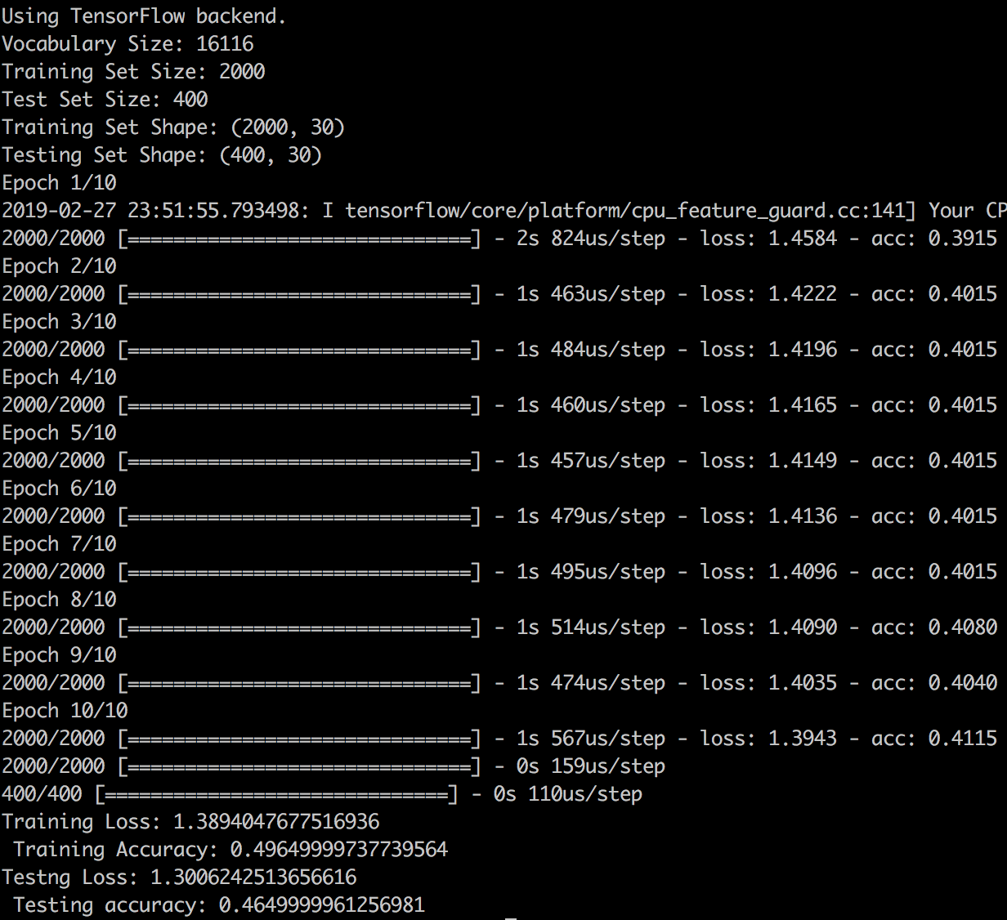
Test Your Code
$ python tut3_skeleton.py
Done!

Slide 16
Thank You

